Slide 1
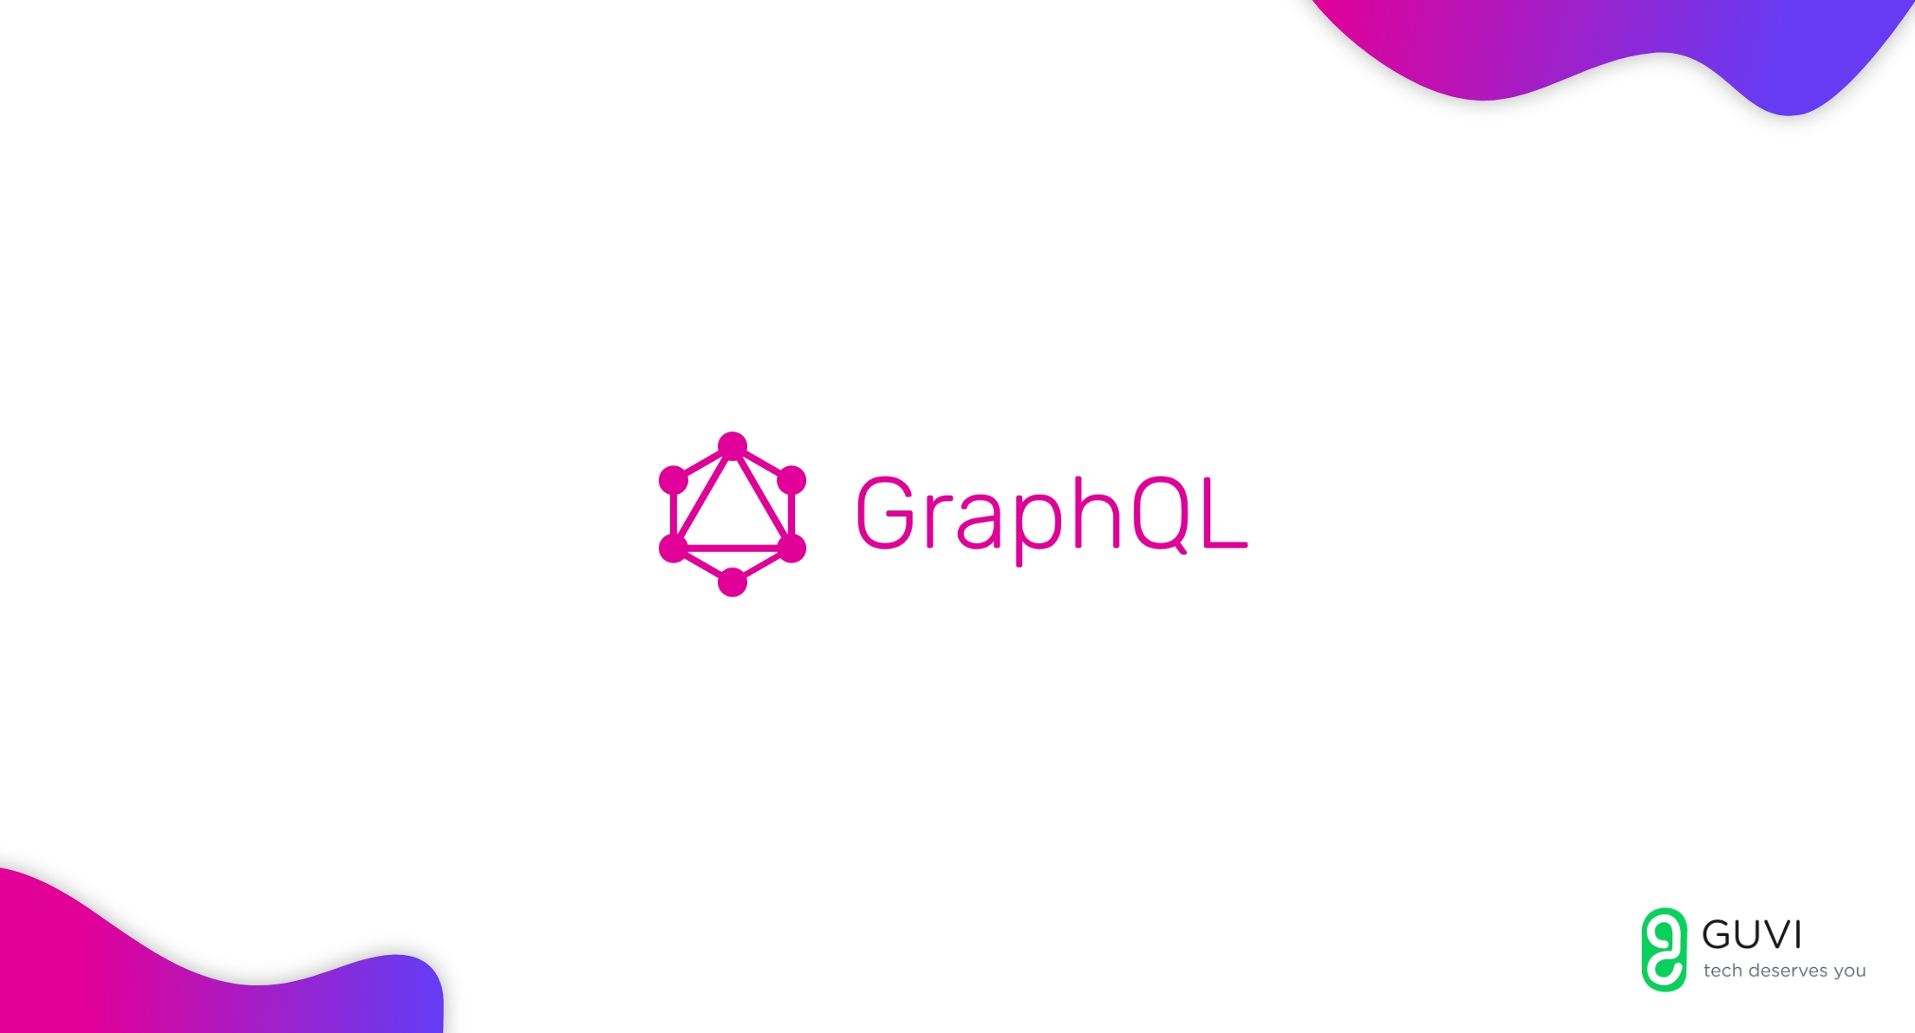

Slide 2

REST – a simple idea
Don’t reinvent anything
HTTP
Client-server
Stateless
Cached
Uniform Interface
Treat everything as resource
Strict officer – REST
Developer – not a developer
WWW – Wild Wild West
Rapidly changing environment
REST is stale

Slide 3
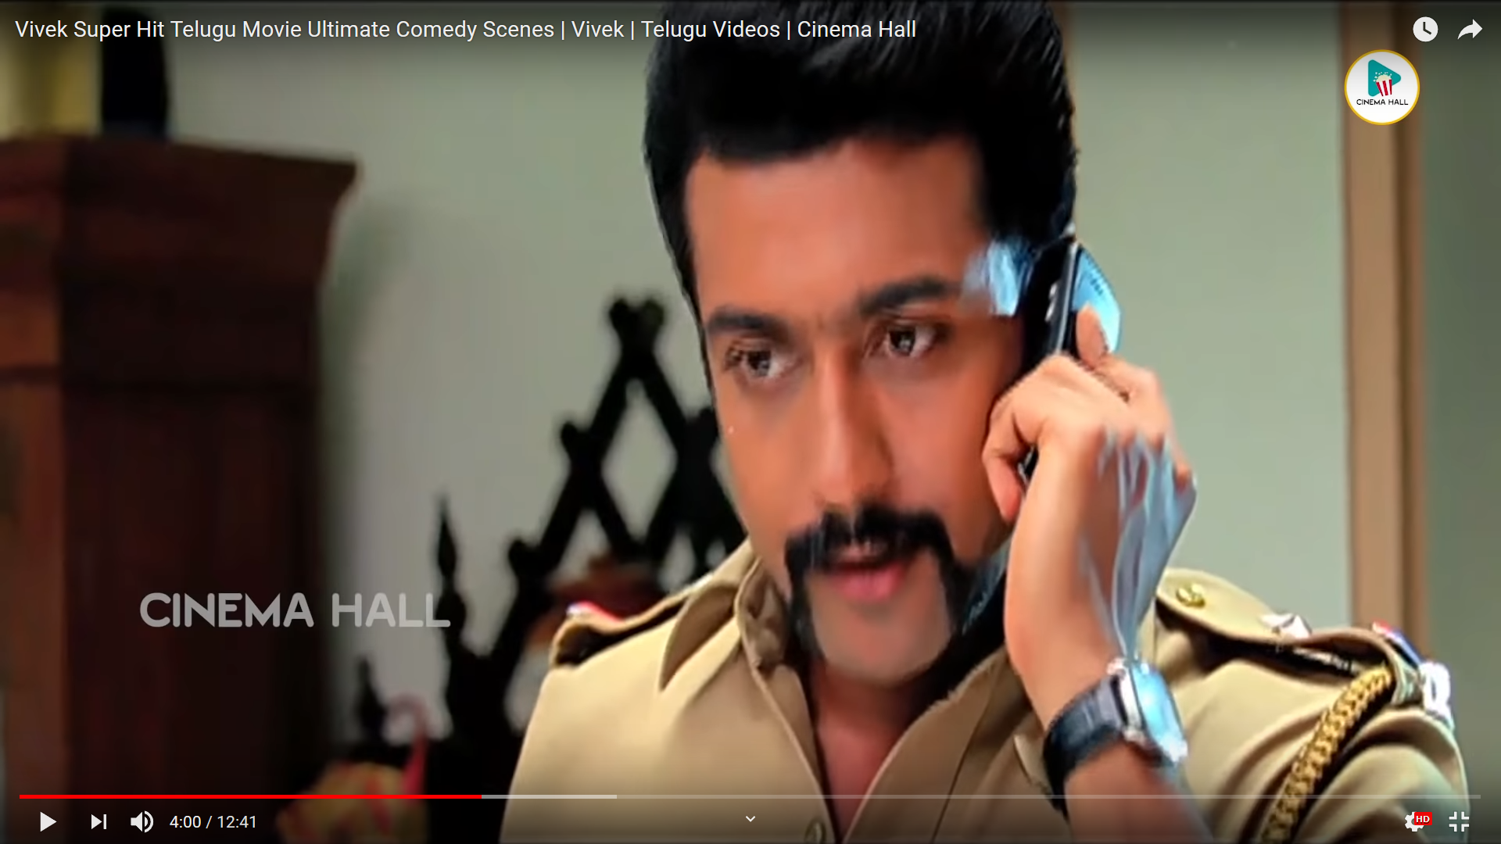

REST
GraphQL?

Slide 4


Slide 5
Why GraphQL? – From FB view
Back in 2012, we began an effort to rebuild Facebook’s native mobile applications.
mobile-webview
they suffered poor performance and frequently crashed
Natively implemented models and views
FQL tables (Facebook’s SQL-like API)
Considerable amount of code to write on both the server to prepare the data and on the client to parse it

Slide 6
What is GraphQL?
A GraphQL query is a string that is sent to a server to be interpreted and fulfilled, which then returns JSON back to the client.
A query language for your API
Fulfilling those queries with your existing data
makes it easier to evolve APIs over time
gives clients the power to ask for exactly what they need

Slide 7
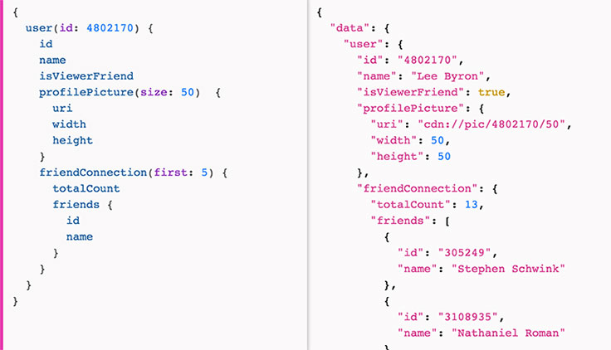
What is GraphQL?

Slide 8
What is GraphQL?
Defines a data shape
Hierarchical
Strongly typed
Protocol, not storage
Introspective
Version free
https://graphql.github.io/graphql-spec/
OWFa 1.0 in 2017. Copyright and trademark was transfered to the GraphQL Foundation in 2019

Slide 9
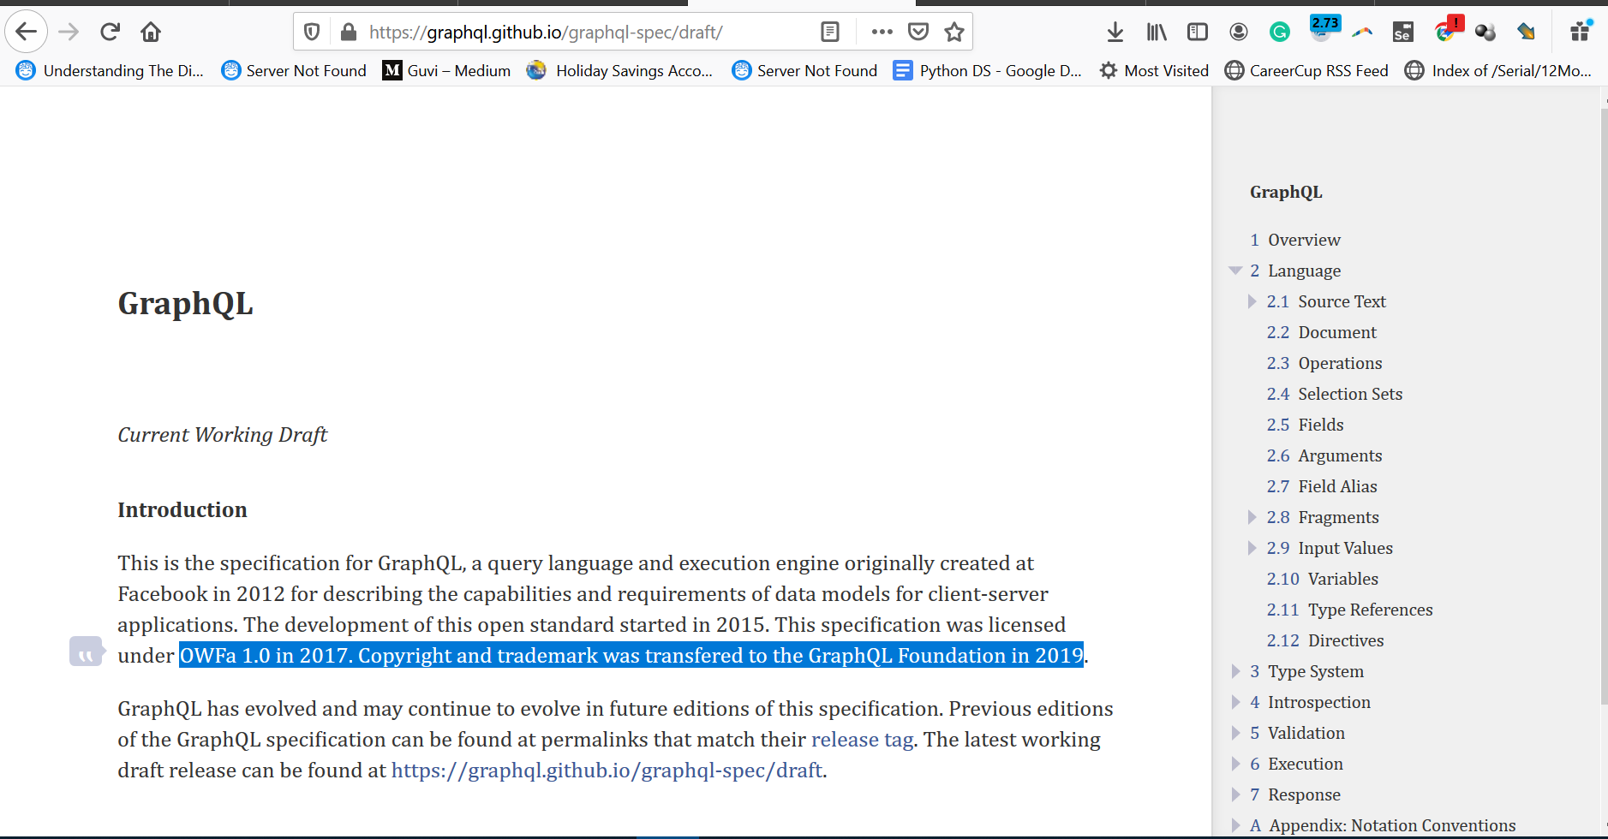

Slide 10
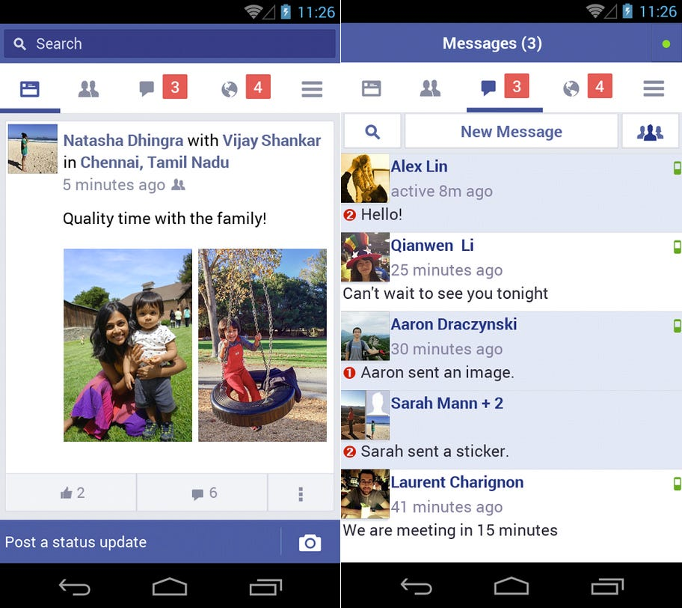
Posts -> ids
Id -> name , active time , msg , image
1 + 4 requests
Think in scale → 2.41 b
10% → 20 M requests
20 * 5 → 100 M or 1 B r
https://graphql.org/swapi-graphql

Slide 11
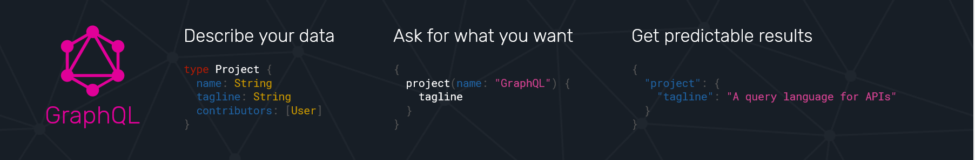

Slide 12
/users
/ users /courses/status
/ users / certificates
/ users / jobs
Query{
Users{
courses,
certificates,
jobs
}
}
API
API
API
API
API

Slide 13
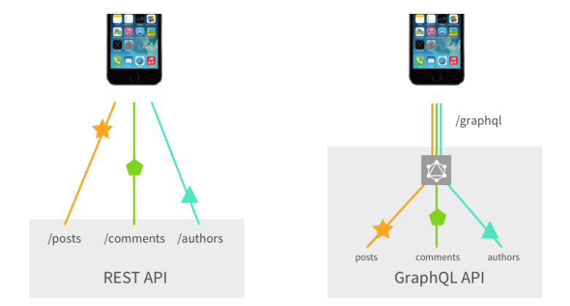

Slide 14
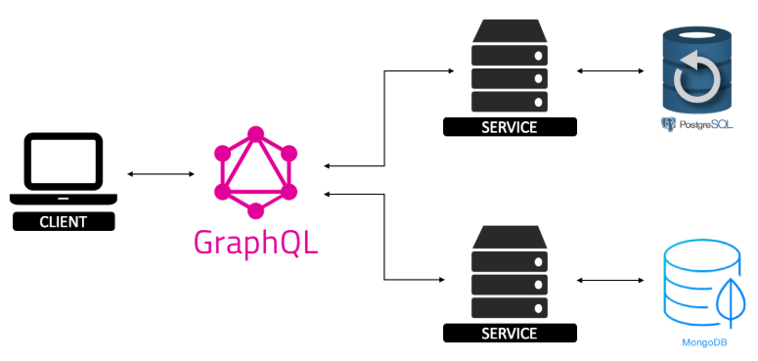

Slide 15
Architectures that include a GraphQL server
Connected database
GraphQL server that is a thin layer in front of a number of third party or legacy systems and integrates them through a single GraphQL API
A hybrid approach of a connected database and third party or legacy systems that can all be accessed through the same GraphQL API

Slide 16
Schema Definition Language (SDL)
Queries
type Person {
name: String!
age: Int!
}
type Post {
title: String!
author: Person!
}
{
allPersons {
name
}
}
{
allPersons(last: 2) {
name
}
}
type Person {
name: String!
age: Int!
posts: [Post!]!
}
https://www.howtographql.com/

Slide 17
mutation {
createPerson(name: "Bob", age: 36) {
name
age
}
}
subscription {
newPerson {
name
age
}
}
https://www.howtographql.com/

Slide 18
Inside GraphQL
GraphQL schema
Queries
Mutations
Subscriptions

Slide 19


Slide 21
Demo Time
Credits: https://medium.com/@marvinkome/creating-a-graphql-server-with-flask-ae767c7e2525

